Slide 1
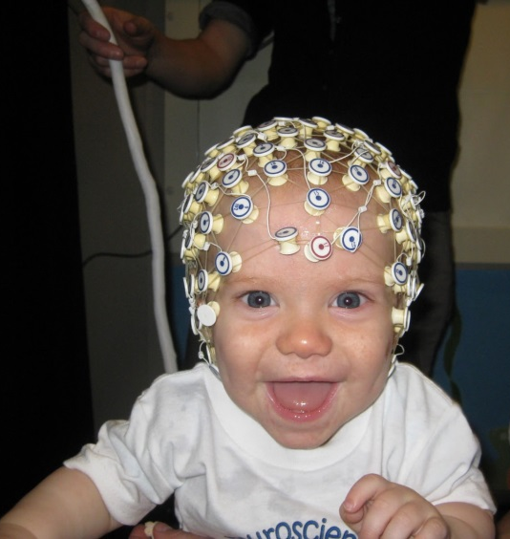
EEG preprocessing in EEG Lab
-Nithya rAMAKRISHNAN
Summary of NOTES MAINLY TAKEN FROM EEGLAB WIKI PAGE

Slide 2
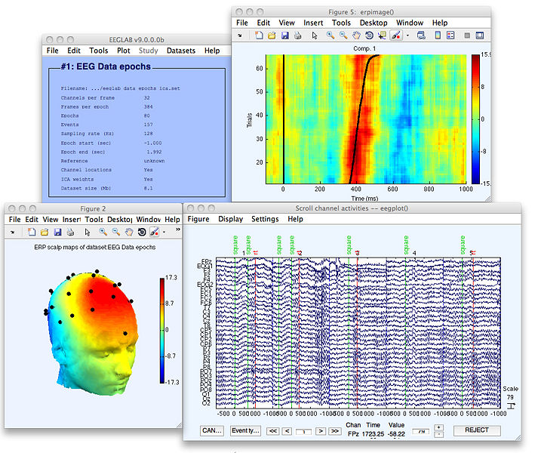
Eeg lAB
EEGLAB provides an interactive graphic user interface (gui) allowing users to flexibly and interactively process their high-density EEG and other dynamic brain data using independent component analysis (ICA) and/or time/frequency analysis (TFA), as well as standard averaging methods.
EEGLAB offers a structured programming environment for storing, accessing, measuring, manipulating and visualizing event-related EEG, MEG, or other electrophysiological data
It is open source – Contribute a plug in

Slide 3
GUI HELP
File menu --- read/load and store/save datasets and studysets
Edit menu ---- allow editing a dataset, changing its properties, reviewing and modifying its event and channel information structures
Tools menu ----extract epochs from continuous data (or sub-epochs from data epochs), perform frequency filtering, baseline removal, and ICA, and can assist the user in performing semi-automated artifact data rejection based on a variety of statistical methods applied to activity in the raw electrode channels or their independent components
Plot menu --- allow users to visualize the data in a variety of formats, via (horizontally and vertically) scrolling displays or as trial (ERP), power spectrum, event-related time/frequency averages, etc. A large number of visualization functions are dedicated to the display and review of properties of scalp data channels and underlying independent data components. The user can make use of standard Matlab capabilities to edit, print, and/or save the resulting plots in a variety of formats
Study menu --- show the current studyset and which of its constituent datasets are currently loaded
Datasets menu --- list loaded datasets, and allows the user to swtich back and forth among them
Help menu--- allow users to call up documentation on EEGLAB functions and data structures, including function lists and scrolling function help messages

Slide 4
Sample experiment description
Two types of events "square" and "rt"; "square" events correspond to the appearance of a green colored square in the display and "rt" to the reaction time of the subject.
In this experiment, the subject covertly attended to the selected location on the computer screen responded with a quick thumb button press only when a square was presented at this location. They were to ignore circles presented either at the attended location or at an unattended location.

Slide 5
PREPROCESSING PIPELINE PART 1
File > Load existing dataset)
Edit > Event Values
Edit > About this dataset.
Plot > Channel data (scroll)
Voltage Scale
Adjusting time range
Number of Channels to Display
Zoom
Grid Lines
Rejecting Data
Zooming must be disabled to select a portion of the data

Slide 6
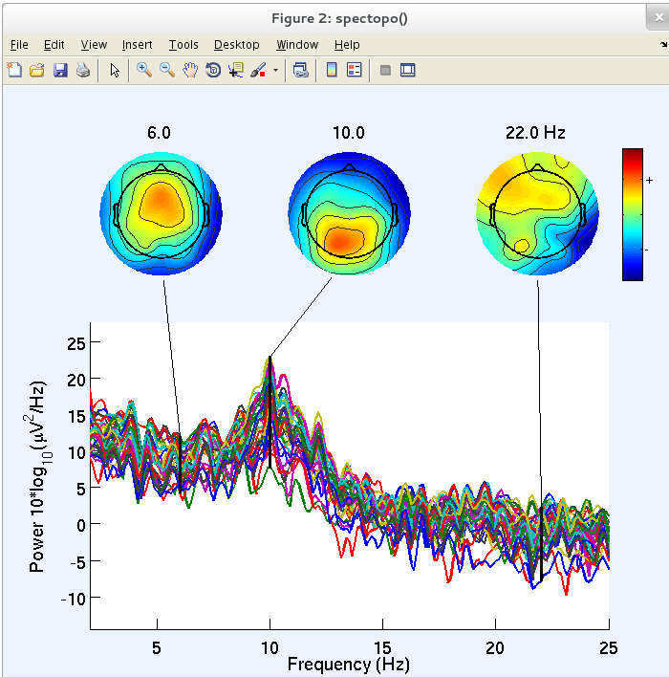
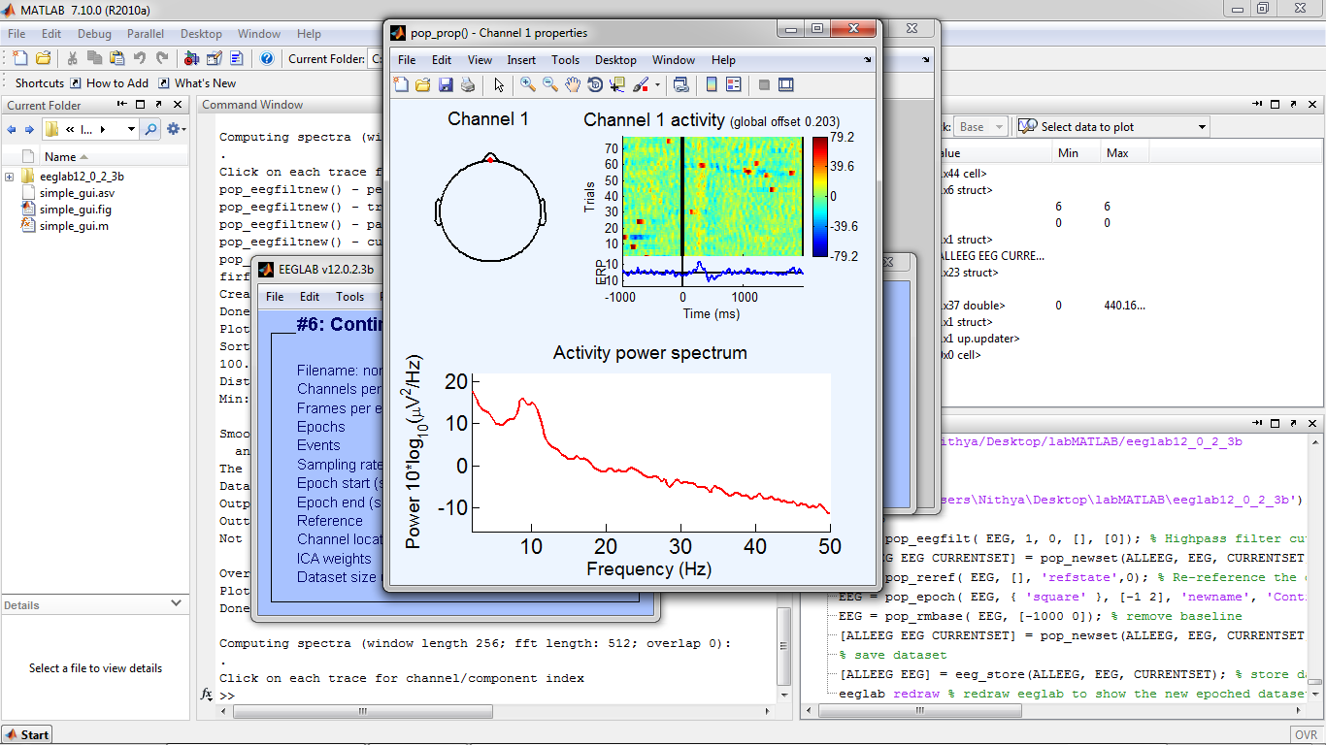
PREPROCESSING PIPELINE PART 2
Edit > Channel locations. Read Locations – edit radius—topographic map
Plot > Channel location > By name
Plot > Channel spectra and maps.
Each colored trace represents the spectrum of the activity of one data channel
Plot > Channel properties- scalp location of a selected channel, its activity spectrum, and an ERP-image plot of its activity in single-epochs.

Slide 7
PREPROCESSING PIPELINE PART 3
Tools > Change sampling rate--- save memory and disk storage
Remove linear trends-Driect Current, it is often desirable to high-pass filter the data
Tools > Filter the data > Basic FIR filter checking the Overwrite parent checkbox,
the low-pass filter and then, in a second call, the high-pass filter (or vice versa).
bandpass filtering is to remove 50-Hz or 60-Hz
Plot > Channel spectra and maps
Tools > Re-reference ----average
Re- Referencing Manually ---- Edit > Channel Locations > select channel > Append button > Look up locs > Set reference re-referencing interface > Retain old reference button.
(ICA decomposition --the selection of reference is not so important)
(Record eye channels (conventionally four channels, two for vertical eye movement detection and two for horizontal eye movement detection) using the same reference as other channels, instead of using bipolar montages)
Tools > Extract Epochs > …extract data epochs time locked to events of interest
Tools > Remove baseline. Removing a mean baseline value from each epoch is useful when baseline differences between data epochs (e.g., those arising from low frequency drifts or artifacts) are present---- skew data analysis
Mean value can be used to find difference in data after time locking event
File > Save current dataset or File > Save current dataset

Slide 8
Rejecting artifacts seven-stage method
Rejecting artifacts in continuous data
Rejecting data by visual inspection---boundary events ('before' separating it into data epochs)
Rejecting data channels based on channel statistics
Rejecting artifacts in epoched data
Rejecting epochs by visual inspection
Rejecting extreme values
Rejecting abnormal trends
Rejecting improbable data
Rejecting abnormally distributed data
Rejecting abnormal spectra

Slide 9
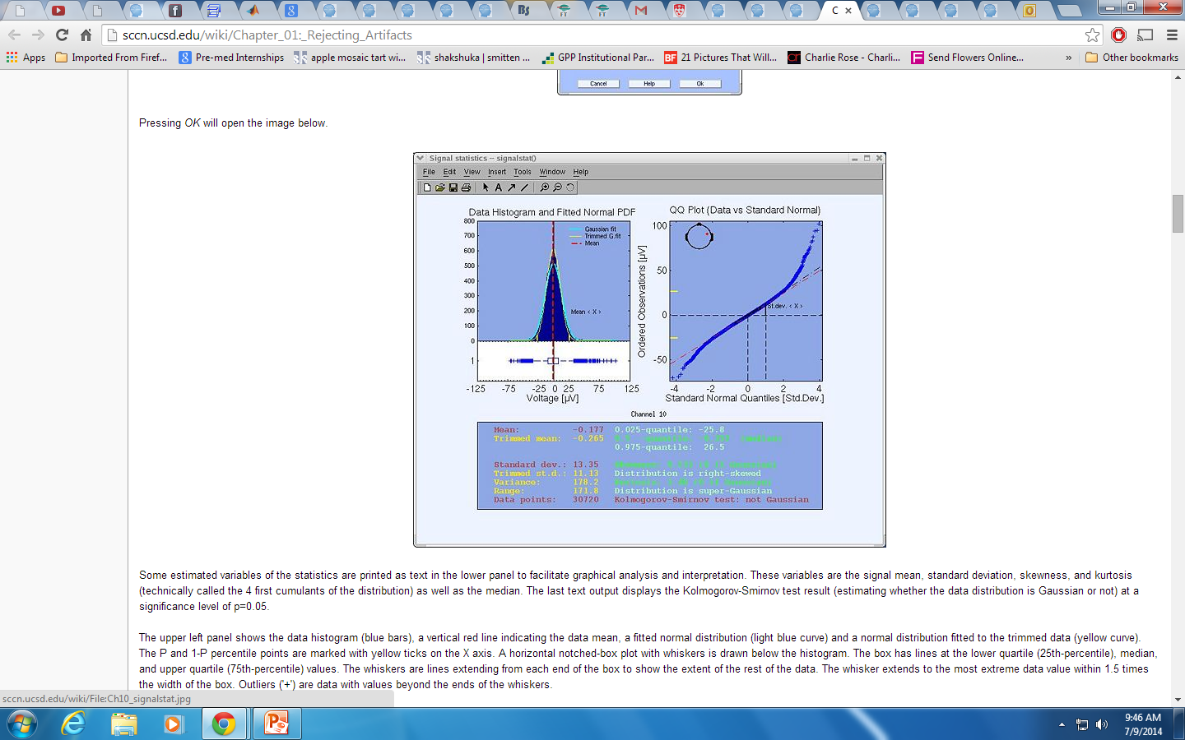
Remove bad channels-based on channel statistics
Plot > Data statistics > channel statistics.
signal mean, standard deviation, skewness, and kurtosis
Mean
a fitted normal distribution(light blue curve)
a normal distribution fitted to the trimmed data (yellow curve)
P and 1-P percentile points are marked with yellow ticks on the X axis
lower quartile (25th-percentile), median, and upper quartile (75th-percentile) values.

Slide 10
Loading epoch data
EEG = pop_eegfilt( EEG, 1, 0, [], [0]); % Highpass filter cutoff freq. 1Hz.
[ALLEEG EEG CURRENTSET] = pop_newset(ALLEEG, EEG, CURRENTSET, 'setname', 'Continuous EEG Data'); % Save as new dataset.
EEG = pop_reref( EEG, [], 'refstate',0); % Re-reference the data
EEG = pop_epoch( EEG, { 'square' }, [-1 2], 'newname', 'Continuous EEG Data epochs', 'epochinfo', 'yes'); % Epoch dataset using 'square' events.
EEG = pop_rmbase( EEG, [-1000 0]); % remove baseline
[ALLEEG EEG CURRENTSET] = pop_newset(ALLEEG, EEG, CURRENTSET, 'setname', 'Continuous EEG Data epochs', 'overwrite', 'on');
% save dataset
[ALLEEG EEG] = eeg_store(ALLEEG, EEG, CURRENTSET); % store dataset
eeglab redraw % redraw eeglab to show the new epoched dataset

Slide 11
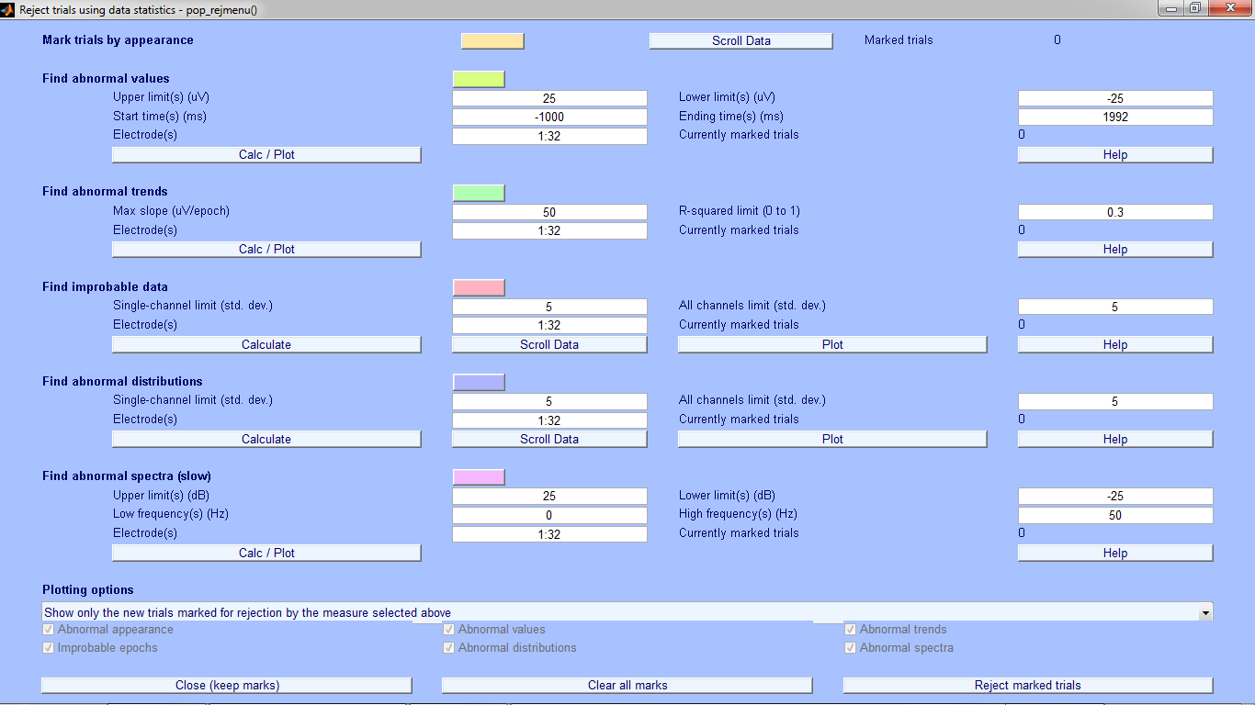
Rejecting artifacts in epoched data
Tools > Reject data epochs > Reject data (all methods). Show only the new trials marked for rejection by the measure selected above

Slide 12
Rejecting Artifacts
Visual inspection
Rejecting extreme values EEG values should not exceed +/-75 µV in any of the 32 channels (1:32) at any time within the epoch (-1000 to 2000 ms)
Rejecting abnormal trends Artifactual currents may cause linear drift to occur at some electrodes----fits the data to a straight line and marks the trial for rejection if the slope exceeds a given threshold. The minimal fit between the EEG data and a line of minimal slope is determined using a standard R-square measure.
Rejecting improbable data Probability distribution of values across the data epochs, one can compute the probability of occurrence of each trial. probability measure value for every trial and electrode (each number at the bottom shows an electrode, the blue traces the trial values---the panel containing the green lines shows the probability measure over all the electrodes.
Rejecting abnormally distributed data Artifactual data epochs sometimes have very 'peaky' activity value distributions. the activity will be either close to one value or the other Detected using kurtosis . A high positive kurtosis value indicates an abnormally 'peaky' distribution of activity in a data epoch, while a high negative kurtosis value indicates abnormally flat activity distribution. --- single- and all-channel thresholds are defined in terms of standard deviations from mean kurtosis value.
Rejecting abnormal spectra rejecting data epochs using spectral estimates may be the most effective method for selecting data epochs → thresholds are expressed in terms of amplitude changes relative to baseline in dB. To specify that the spectrum should not deviate from baseline by +/-50 dB in the 0-2 Hz frequency window, enter the following parameters under find abnormal spectra (which calls function pop_rejspec.m), then press CALC/PLOT.

Slide 13
additional
Inspecting current versus previously proposed rejections
Show previous and new trials marked for rejection by this measure selected above.
Inspecting results of all rejection measures
Show all trials marked for rejection measures by the measure selected above or checked below

Slide 14
UNITL PLOTTING ERP
Plot > Channel ERPs> With scalp maps
Plot > Channel ERPs > In scalp array/rect. Array
average ERP data traces in two column array--"Plot in rect. array" checkbox
Plot > ERP map series > In 2-D
Plot > ERP map series > In 3-D
Create datasets containing epochs for each condition ---half the targets appeared at position 1 and the other half at position 2
Edit > Select epochs or events. Enter "1" in the textbox next to position, which will select all epochs in which the target appeared in position
name this new dataset---Square, Position 1
Datasets > Continuous EEG Data epochs,---Edit > Select epoch/events. Position 2, square
Plot > Sum/Compare ERPs
datasets ‘3’ and ‘4’.
0.05 for the t-test significance probability (p) threshold
http://sccn.ucsd.edu/wiki/Chapter_07:_Selecting_Data_Epochs_and_Comparing

Slide 15
Difference between eeg and field trip
Both EEGLAB and FieldTrip work with data structures in MATLAB memory. The design philosophy in EEGLAB is to gather all data from one subject in a single “EEG” structure, and all data from a group of subjects in a “STUDY” structure. This is different from the design philosophy of FieldTrip, which does not gather all results in a single structure, but keeps the results from different analyses in different structures.

